Slide 1
Prepared August 9, 2021,
by the Data on Call Section (eocevent462@cdc.gov) within Data, Analytics, and Visualization Task Force​

Slide 2
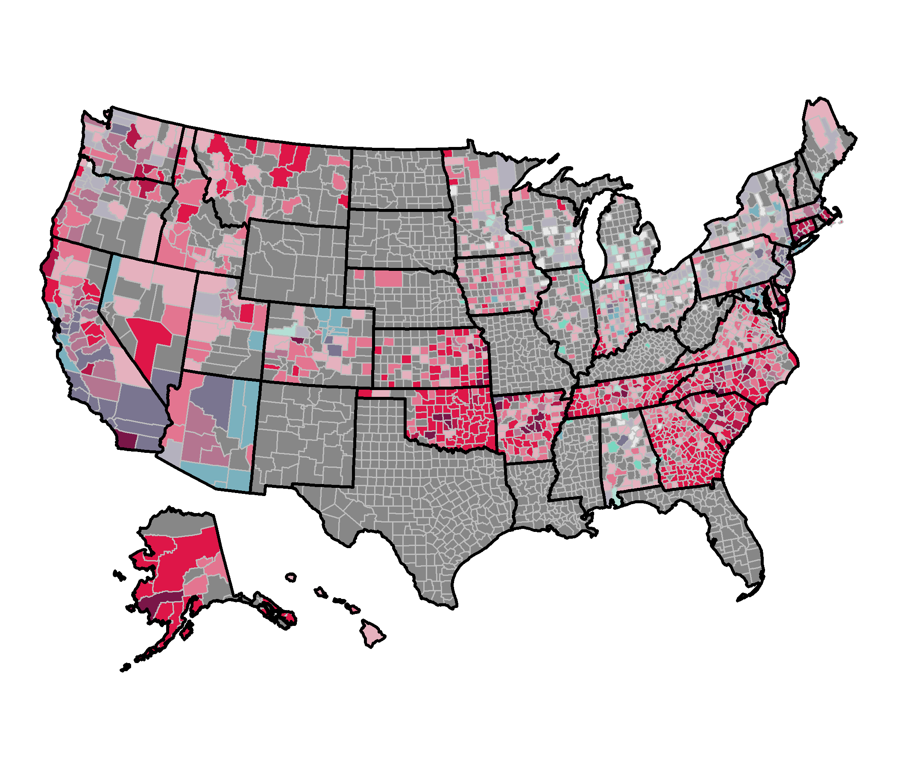
Counties by Percentage of Fully Vaccinated and 7-Day Case Rates for Ages 0 – 17 Years – July 29 – August 4 , 2021 – based on Jenks Natural Breaks for Vaccine Coverage
7-Day Case Rate
(lower to higher)
% Fully Vaccinated
% Fully Vaccinated | 7-Day Case Rate
 | Low (<10) | >=10 | >=50 | High (>=100) | No data | Total
>0.9 - 5.2 | 0 | 1 | 0 | 0 | 0 | 1
>0.2 - 0.9 | 16 | 38 | 53 | 31 | 55 | 193
>0.1 - 0.2 | 39 | 113 | 77 | 68 | 102 | 399
0 - 0.1% | 48 | 341 | 289 | 385 | 1,484 | 2,547
No data | 0 | 0 | 0 | 0 | 2 | 2
Total | 103 | 493 | 419 | 484 | 1,643 | 3,142
Counties appear in grey in map where either case rate or vaccine data is not available. Jenks Natural breaks used for vaccine levels include: High is >0.9% - 5.2%.; Substantial: 0.9% - >0.2%; Moderate: 0.2% ->0.1%; Low: 0 – 0.1% Seven-day period is from July 29 to August 4, 2021.
Data received by CDC as of 6:00 am ET on August 05, 2021

Slide 3

Counties by Percentage of Fully Vaccinated and 7-Day Case Rates for Ages 0 – 17 Years – July 29 – August 4, 2021 – based on Quartiles for Vaccine Coverage
7-Day Case Rate
(lower to higher)
% Fully Vaccinated
 | 7-Day Case Rate
% Fully Vaccinated | Low (<10) | >=10 | >=50 | High (>=100) | No data | Total
>0.2 - 5.2 | 15 | 35 | 45 | 25 | 50 | 170
>0.18 - 0.2 | 12 | 49 | 39 | 24 | 45 | 169
>0.1 - 0.18 | 16 | 51 | 31 | 36 | 36 | 170
0 - 0.1 | 60 | 358 | 304 | 399 | 1,510 | 2,631
No data | 0 | 0 | 0 | 0 | 2 | 2
Total | 103 | 493 | 419 | 484 | 1,643 | 3,142
Counties appear in grey in map where either case rate or vaccine data is not available. Quartiles used for vaccine levels include: High is >0.2% - 5.2%.; Substantial: >0.18% - 0.2%; Moderate: >0.1% -0.18%; Low: 0 – 0.1%. Seven-day period is from July 29 to August 4, 2021.
Data received by CDC as of 6:00 am ET on August 05, 2021

